Slide 1

Brief Introduction of Java 7
Kun Zhou
Notes:
To change the image on this slide, select the picture and delete it. Then click the Pictures icon in the placeholder to insert your own image.

Slide 2
Agenda
Introducing Java 7
Project Coin
Small changes brought by Project Coin
NIO2
Path
File Operations and File Attributes
Working with Directory
Reading and writing files
WatchService
Asynchronous I/O

Slide 3
Project Coin
Project Coin is an open source project that has been running as part of the Java 7 (and 8) effort since January 2009.
The goal of Project Coin is to determine what set of small language changes should be added to JDK7. (After discussion, 5 out of 70 proposals were selected for JDK7)
Java7 is the first version developed in an open source manner

Slide 4
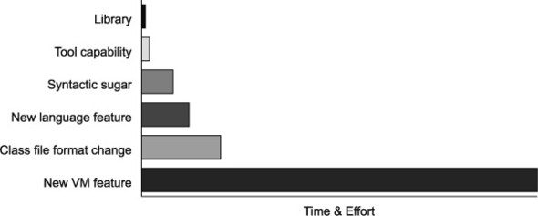
Project Coin
The relative effort involved in implementing new functionality in different ways
Syntactic sugar— Underscores in numbers (Java 7)
Small new language feature— try-with-resources (Java 7)
Class file format change— Annotations (Java 5)
New JVM feature—invokedynamic (Java 7)

Slide 5
Project Coin - Proposal Judgement Rules
Submit a detailed proposal form describing their change (which should fundamentally be a Java language change, rather than a virtual machine change)
Discuss their proposal openly on a mailing list and field constructive criticism from the other participants
Be prepared to produce a prototype set of patches that could implement their change

Slide 6
Project Coin – Java 7
Project Coin brought six main new features to Java7:
Strings in switch
Enhanced syntax for numeric literals
Improved exception handling
Try-with-resources
Diamond syntax
Simplified varargs method invocation

Slide 7
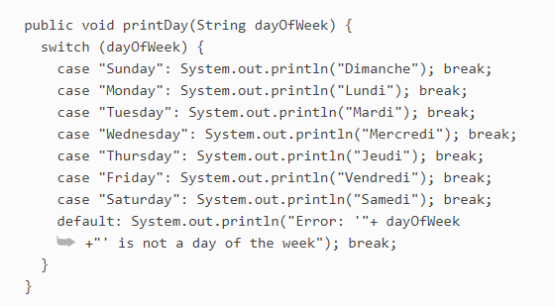
Project Coin – Strings in swich
In Java 6 and before, the values for the cases could only be constants of type byte, char, short, int or enum constants. With Java 7, the spec has been extended to allow for the String type to be used as well.

Slide 8



Project Coin - Enhanced syntax for numeric literals
Numeric constants (that is, one of the integer primitive types) may now be expressed as binary literals.
Underscores may be used in integer constants to improve readability

Slide 9
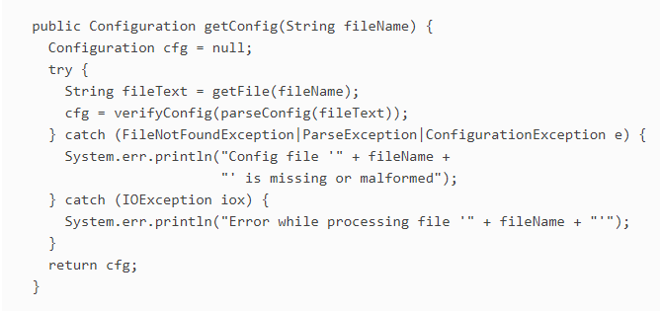
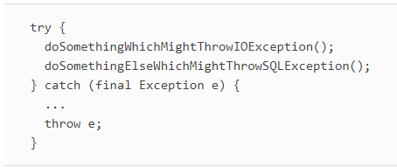
Project Coin – Improved exception handling
Multicatch
Final rethrow

Slide 10
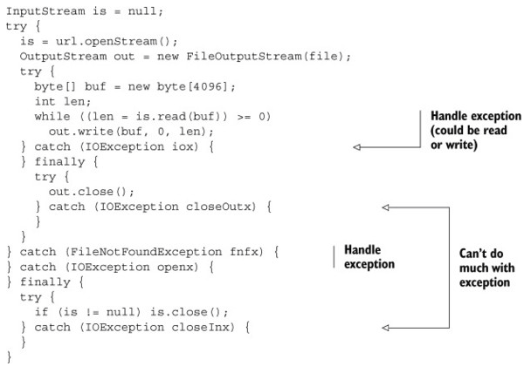
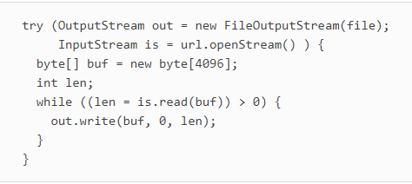
Project Coin – Try-with-resources
Implement AutoCloseable to use the TWR feature

Slide 11
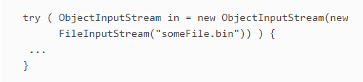
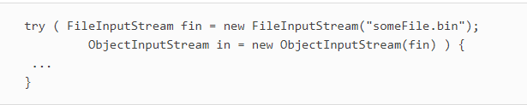
Project Coin – Try-with-resources

Slide 12

Project Coin – Diamond syntax

Slide 13
NIO.2 - Path
The concept of a location - the Path class is a programmatic representation of a path in the file system. It is the new foundation for file and directory based I/O.
Path path = Paths.get(“root/element1/element2/…”);
JVM only binds a Path to the physical location at runtime
This interface extends Watchable interface so that a directory located by a path can be registered with a WatchService and entries in the directory watched.

Slide 14
NIO.2 - Path
Useful methods (Most of these methods don’t require that the file corresponding to the Path exists.):
getFileName()
getName(index)
getNameCount()
Subpath(start index, end index)
getParent()
getRoot()

Slide 15
NIO.2 - Path
normalize()
toAbsolutePath
toRealPath() combines toAbsolutePath() and normalize() and could resolve symbolic links. This method will check the existence and availability of the file.
resolve()
relativize()
Support equals, startsWith and endWith
Path also implements the Iterable. You can iterate over the name elements in the path through iterator.

Slide 16
NIO.2 – File Operation and File Attributes
Files.createFile(path, attr)
Files.delete(path)
Files.copy(path, path)
Files.move(path, path) – atomic
BasicFileAttributes defines the common set of attributes most filesystems support
java.nio.file.attribute package contains a list of provided file permission classes

Slide 17
NIO.2 – Working with Directory
DirectoryStream
Allows to iterate over entries in a directory using Files.newDirectoryStream(path, glob).
You can use the pattern-matching filter to list specific files. The pattern matching that’s used is called a glob pattern match.
Glob
A glob pattern is specified as a string and is matched against other strings, such as directory or file names. It’s something like wildcard
You can use glob syntax to specify pattern-matching behavior.
Examples: “*.html” , “???”, “a?*.java”

Slide 18
NIO.2 – Working with Directory
Files.walkFileTree(path, FileVisitor<>)
Walking the directory tree recursively. Need to implement FileVisitor.
preVisitDirectory
visitFile
visitFileFailed
postVisitDirectory

Slide 19
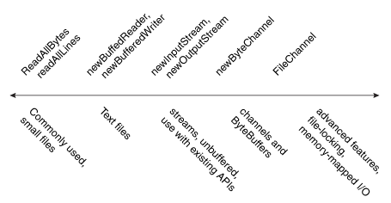
NIO.2 - Reading and writing files
Provide bridge to old I/O
BufferReader and BufferWriter
InputStream and OutputStream
Provide new reading and writing helpers
Files.readAllLines
Files.write

Slide 20
NIO.2 – Reading and writing Files
For small Files:
Files.readAllBytes(Path)
Files.readAllLines(Path, Charset)
Files.write(Path, byte[])
Files.write(Path, Iterable<? Extens CharSequence>)
Buffered I/O for text file:
Files. newBufferedReader(Path, Charset)
Files. newBufferedWriter(Path, Charset, OpenOption...)
Interoperable with Streams:
Files. newInputStream(Path, OpenOption...)
Files. newOutputStream(Path, OpenOption...)

Slide 21
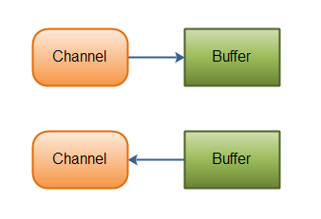
NIO.2 – Channels
While stream I/O reads a character at a time, channel I/O reads a buffer at a time. The ByteChannel interface provices basic read and write functionality.
NIO – buffer oriented IO

Slide 22
NIO.2 - Channels
SeekableByteChannel – a ByteChannel that can maintain a position in the channel and allows the position to be changed. (the newByteChannel method will return an instance of SeekableByteChannel which by default is FileChannel )
Files.newByteChannel()
read()
write()
FileChannel can specify the absolute position to read or write.

Slide 23
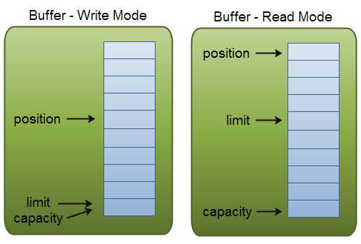
NIO.2 - ByteBuffer
NIO provides a bunch of Buffers to perform fast low level I/O. Usually it is used with channels.
Capacity
Limit
Position
Mark

Slide 24
NIO.2 - ByteBuffer
put() and ByteChannel.read()
get() and ByteChannel.write()
rewind()
flip()
clear()
wrap()

Slide 25
NIO.2 - WatchService
Could be used for directory change notification
WatchService uses client threads to keep an eye on registered files or directories for changes, and will return an event when a change is detected.
Use WatchService to monitor directory:
Watchable object
WatchKey
WatchService

Slide 26
NIO.2 - WatchService
Key methods:
Watchable.register
WatchService.take or WatchService.poll the first one will wait for a timeout if no WatchKey is queued
WatchKey.pollEvents
WatchKey.reset
A watch service is safe for use by multiple concurrent consumers. To ensure that only one consumer processes the events for a particular object at any time then care should be taken to ensure that the key's reset method is only invoked after its events have been processed.
ready—(event happen)->signaled—(reset)->ready
The key remains valid until:
1. It is cancelled, explicitly, by invoking its cancel method, or
2. Cancelled implicitly, because the object is no longer accessible, or
3. By closing the watch service.

Slide 27
NIO.2 - Asynchronous I/O
Asynchronous Channels:
AsynchronousFileChannel—For file I/O
AsynchronousSocketChannel—For socket I/O, supports timeouts
AsynchronousServerSocketChannel—For asynchronous sockets accepting connections
Paradigms
Future
Callback

Slide 28
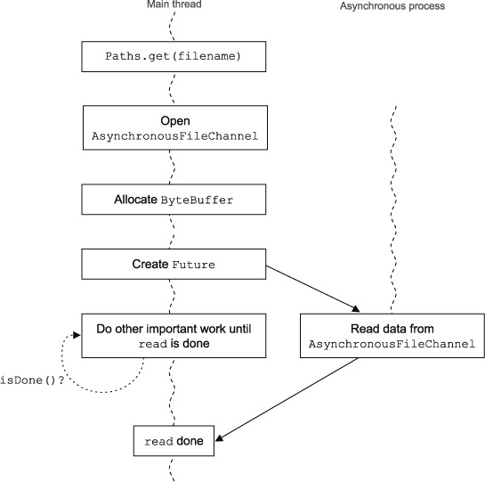
NIO.2 – Future style
You’ll typically want a Future style of asynchronous processing if you want your main thread of control to initiate the I/O and then poll for the results of that I/O.
This style uses the existing java.util.concurrent technique.

Slide 29
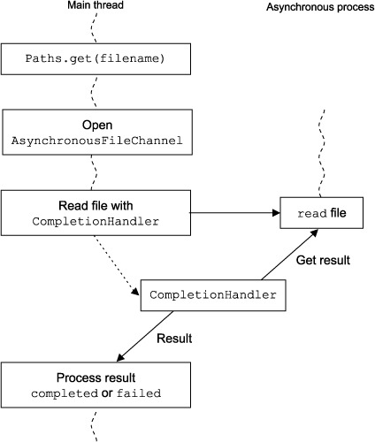
NIO.2 - Callback style
This style is typically used when you want to immediately act upon the success or failure of an asynchronous event.
To use this style, you need to implement the CompletionHandler which act as an event handler.

Slide 30
References
References:
https://docs.oracle.com/javase/tutorial/essential/io/index.html
https://www.safaribooksonline.com/library/view/the-well-grounded-java/
http://tutorials.jenkov.com/java-nio/overview.html

Slide 31


